Slide 1
MARKET VIEW December 2025
Trends for the Greek FMCG environment

Slide 2
Study ID
Metrics
Channels
01
02
Value and Units Sales Trends:
Super/Hyper Markets FMCG
Random Weight Value Sales Trends : Super/Hyper Markets
Super/Hyper Markets
(Self-service retail stores with a central check-out area and at least 2 cash registers)
Areas
Periods
03
04
Greece Mainland & Crete + Islands
YR 2025 vs YR 2024

Slide 3
01
Greek Economy

Slide 4
Greek Economy
GDP
RETAIL TURNOVER INDEX (w.o AUTOMOTIVE FUEL)
INFLATION RATE TREND
UNEMPLOYMENT
Source: ELSTAT (latest available period/provisional data

Slide 5
02
Trends for FMCG Market
Fixed Barcodes + Random Weight

Slide 6
FMCG Value Sales Trend - Year 2025
!
Incl. Islands
Growth by 6.1% for Total FMCG Market in 2025, coming from both Segments
2025 Value Contribution
Value Sales (in Millions)
Source: Circana InfoScan, HM/SM + Random Weight, Year 2025

Slide 7
FMCG Value Sales Trend – Year 2025
!
Incl. Islands
Food contributed in a more intense way to Total FMCG growth in Year 2025
2025 Value Contribution
TTL FOOD 82.6%
Source: Circana InfoScan, HM/SM + Random Weight, Year 2025

Slide 8
03
Trends for FMCG Market
Fixed Barcodes

Slide 9

FMCG Value Sales Trends per Store Type YTD
All Shop Types achieve growth during Year 2025, more intense for Hyper and Small
2500+ sqm
11.9pp
+6.9%
1000-2500 sqm
43.5pp
+5.3%
400-1000 sqm
32.5pp
+3.7%
0-400 sqm
12.0pp
+6.8%
!
Excl. Islands
Source: Circana InfoScan, HM/SM , Year 2025

Slide 10
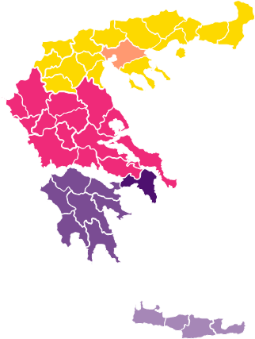
FMCG Value Sales Trends per Geo YTD
!
Incl. Islands
More intense increase for Islands and Crete
North : 11,3pp (+4,2%)
Salonica : 9,8pp (+5,7%)
Center : 12,4pp (+4,6%)
Islands : 9,0pp (+9,2%)
Attica : 41,9pp (+4,9%)
Pel/sos : 8,1pp (+5,9%)
Crete : 7,3pp (+7,4%)
Source: Circana InfoScan, HM/SM, Year 2025

Slide 11
Geos Special Analysis

Slide 12
FMCG Monthly Value Growth
During the last months, both Crete and Islands achieve higher growths than Mainland

Slide 13
FMCG Value Growth during Summers
!
Incl. Islands
Intense growth during Summers for Islands and Crete
Value Growth
Value Contribution

Slide 14
Price Analysis

Slide 15
FMCG Price Trends
!
Incl. Islands
More intense increase in Value for Year 2025
Source: Circana InfoScan, HM/SM , Year 2025

Slide 16
FMCG Value and Unit Monthly Trends
!
Incl. Islands
Price per Unit increase during all months of 2025
YR 2023: +9.7%
YR 2024: +3.1%
YR 2025: +5.5%
Source: Circana InfoScan, HM/SM, Year 2025

Slide 17
04
Giga Categories Evolution

Slide 18



Giga Categories Value Sales Trend
!
Incl. Islands
Food manages the highest increase in Year 2025
2025
+6.4%
+2.1%
+2.1%
Food
Health & Beauty
Household
2024
+4.0%
-0.6%
-0.5%
Source: Circana InfoScan, HM/SM , Year 2025

Slide 19
Giga Categories Unit Sales Trend
!
Incl. Islands
Non Food improve their Unit Sales in a more intense way than their Values
2025
+3.8%
+3.3%
+2.6%
Food
Health & Beauty
Household
2024
+3.2%
+3.4%
+1.8%
Source: Circana InfoScan, HM/SM , Year 2025

Slide 20











Categories Value Sales Trend YTD
!
Incl. Islands
All Food Categories, except Cooking Aids, achieve intense growth in Year 2025
Value Sales Trend 2025
PACKAGED FOOD
SNACKS
DAIRY
FROZEN FOOD
COOKING AIDS, INGREDIENTS & CONDIMENTS
NON ALCOHOLIC BEVERAGES
ALCOHOL DRINKS
PERSONAL CARE & BEAUTY
PERSONAL HYGIENE
HOUSEHOLD CLEANERS & DETERGENTS
OTHER HOUSEHOLD PRODUCTS
Value Sales Trend 2024
Source: Circana InfoScan, HM/SM , Year 2025

Slide 21
FMCG Unit Sales Trend YTD
!
Incl. Islands
All Categories achieve growth in terms of Units, most of them with lower growth rate compared to their Values
Unit Sales Trend 2025
PACKAGED FOOD
SNACKS
DAIRY
FROZEN FOOD
COOKING AIDS, INGREDIENTS & CONDIMENTS
NON ALCOHOLIC BEVERAGES
ALCOHOL DRINKS
PERSONAL CARE & BEAUTY
PERSONAL HYGIENE
HOUSEHOLD CLEANERS & DETERGENTS
OTHER HOUSEHOLD PRODUCTS
Unit Sales Trend 2024
Source: Circana InfoScan, HM/SM , Year 2025

Slide 22
05
Evolution of Private Labels

Slide 23
PL and Branded Value Shares and Trends
!
Incl. Islands
More intense increase for PL Products in Year 2025
+2.5%
+4.8%
+4.7%
+7.5%
Source: Circana InfoScan, HM/SM , Year 2025

Slide 24
PL Value Share per Giga Category
!
Incl. Islands
Value Share increase for Food and Household in Year 2025
Source: Circana InfoScan, HM/SM, Year 2025

Slide 25
06
Price Trends & Promo Pressure

Slide 26


%Value Sales due to Temporary Price Reduction
Decreased promo intensity for Total FMCG in Year 2025 for Non Food
!
Incl. Islands
-0.7pp
+0.1pp
-4.3pp
-4.0pp
Source: Circana InfoScan, HM/SM , Year 2025

Slide 27
Price per Unit per Giga Category
!
Incl. Islands
Price increase for Food influences total FMCG in Year 2025
-1.2%
+1.7%
+2.5%
Source: Circana InfoScan, HM/SM , Year 2025

Slide 28
Price per Unit per Category
!
Incl. Islands
Intense price increase for Snacking in Year 2025
Price per Unit
Price evolution
Source: Circana InfoScan, HM/SM , Year 2025

Slide 29
07
Random Weight Categories

Slide 30
Random Weight Value Sales Trend
!
Incl. Islands
Cold Cuts is the only declining category in Year 2025
2025 Contribution
+8.2%
Source: Circana Random Weight,, Year 2025

Slide 31
08
Online Grocery Trends Report

Slide 32
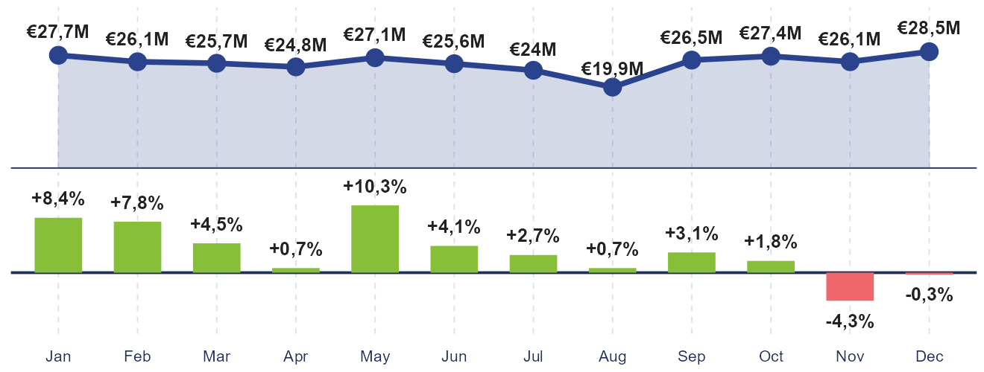
eRetail Audit Panel Turnover
ERETAIL AUDIT PANEL OVERVIEW
2025 ONLINE GROCERY TRENDS REPORT
€310M
+3%
+3%
+4%
-1%
-1%
0%

Slide 33
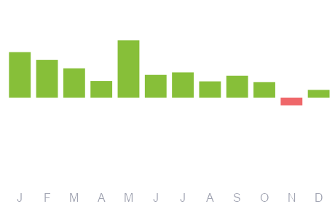
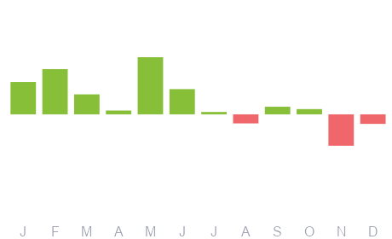
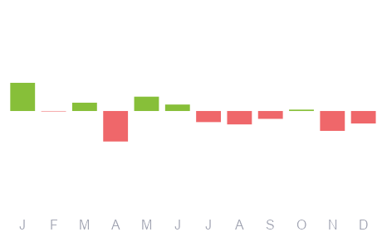
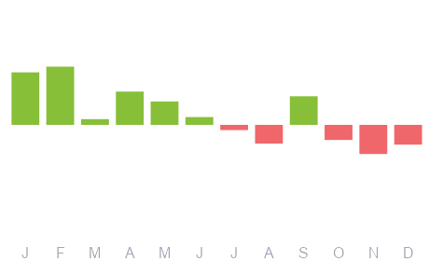
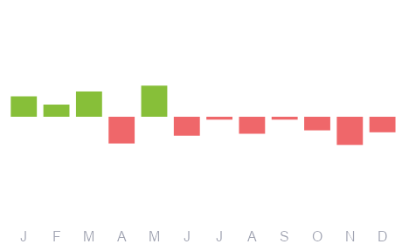
Mega Categories Overview
ERETAIL AUDIT PANEL OVERVIEW
2025 ONLINE GROCERY TRENDS REPORT
1/2
Fresh Food
Basic Packaged Food
Cleaning Products & Paper for Household Use
Bottled Beverages, Soft Drinks, Water & Drink Mixes
Beauty & Health
34%
+1pp
21%
0pp
11%
0pp
11%
0pp
6%
0pp
+6%
+3%
-1%
+2%
-1%
+2pp
+1pp
0pp
0pp
0pp

Slide 34
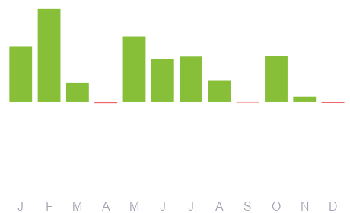
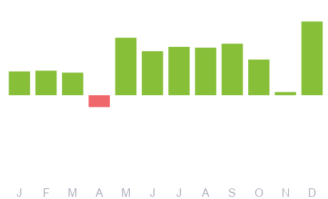
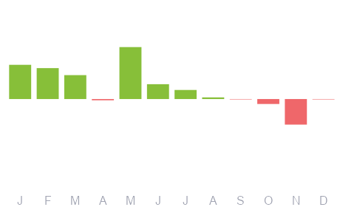
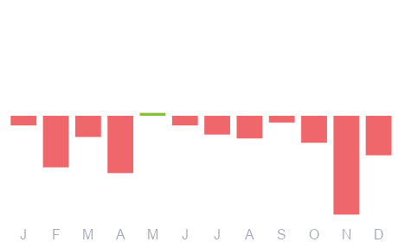
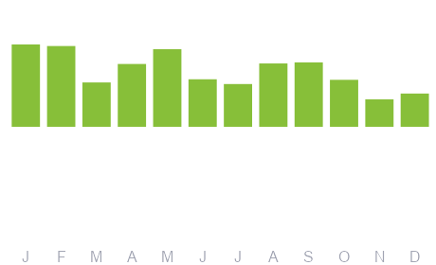
Mega Categories Overview
ERETAIL AUDIT PANEL OVERVIEW
2025 ONLINE GROCERY TRENDS REPORT
2/2
Frozen foods
Other
Bakery
Baby & Kid
Pet Supplies
5%
0pp
4%
0pp
4%
0pp
3%
0pp
1%
0pp
+7%
+9%
+3%
-6%
+10%
0pp
0pp
0pp
0pp
0pp

Slide 35


